Slide 1
TEAM B
MANTHARAGIRI, nANDHA KUMAR, vEERA VENKATA VASANTHA RAYULU BUGIDE, SIRISHA

Slide 2
NANO
Nano is a simple terminal based text editor not powerful as vim it is easy to learn and use, nano ideal for making small changes to existing file.

Slide 3
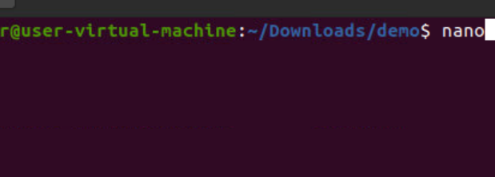

Slide 4
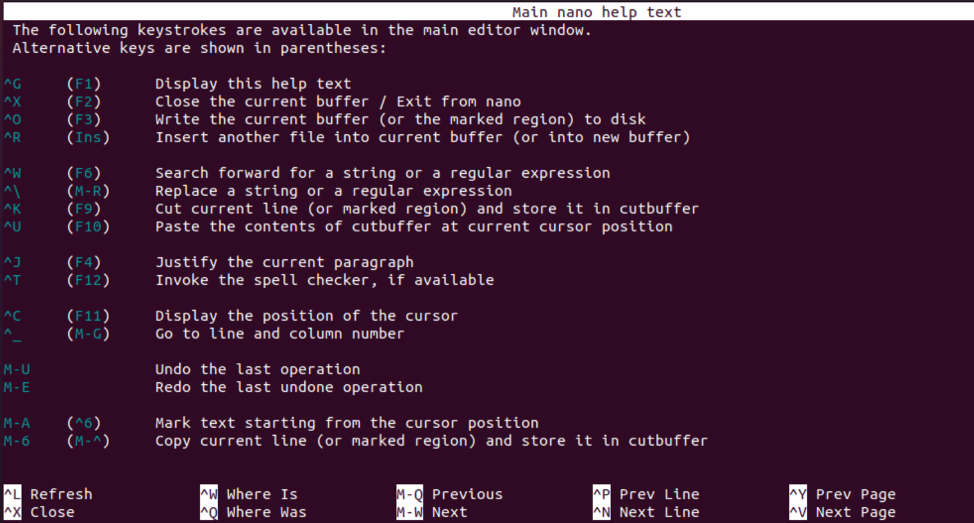

Slide 5
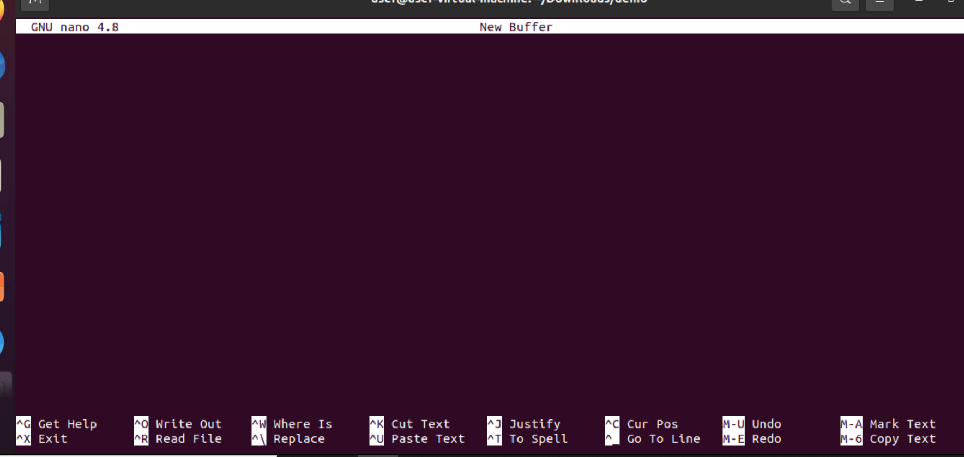

Slide 6
STEPS
Nano →enter
If it is not installed → sudo apt-get -y install nano ( sudo apt install nano)
Control g→ help
Control x → exit from the page
Control k→ to cut the content
Control u → to undo and if you press enter key it will paste the content

Slide 7
STEPS CONTD
Control e → move cursor to the end of the line
Control a → move cursor to the starting of the line
Control o → to save the file (to exit from text editor then control x)
Nano –version → this will version of the nano
Alt a → if you want to select the text press alt a then using arrows you can select the text
If you want to cancel the selection text then control 6 if you want to copy the selected text then alt 6 and control k to cut the text

Slide 8
JED
The Jed is a command-line editor that supports extensive use of the S-Lang library. Jed supports its all flavors for different operating systems such as Linux and Windows. It is a lightweight editor, which makes it an ideal editor for the low configuration systems.
Some key features of Jed editor are as following:
It provides color syntax highlighting on color terminals.
It has code folding support.
It provides drop-down menus on the terminal

Slide 9
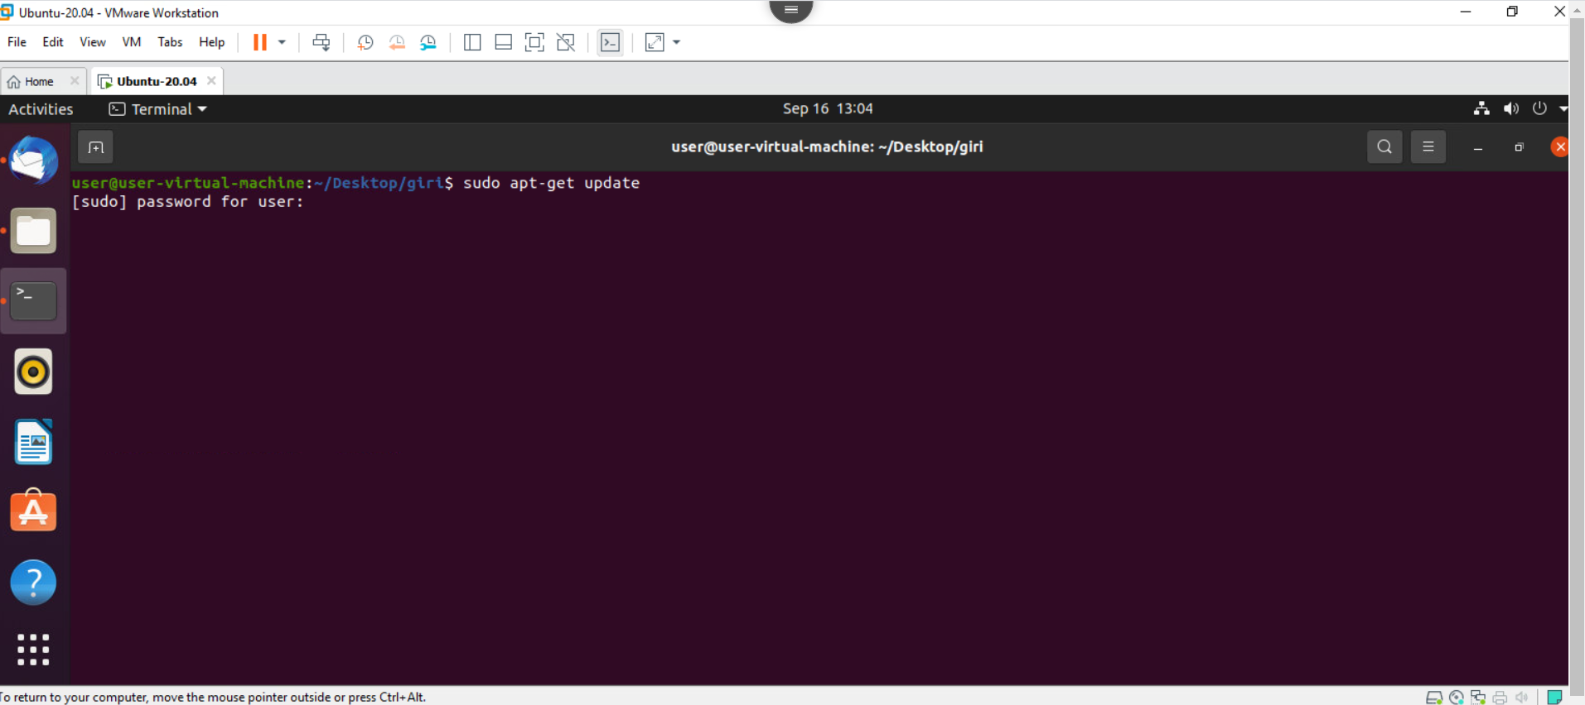

Slide 10
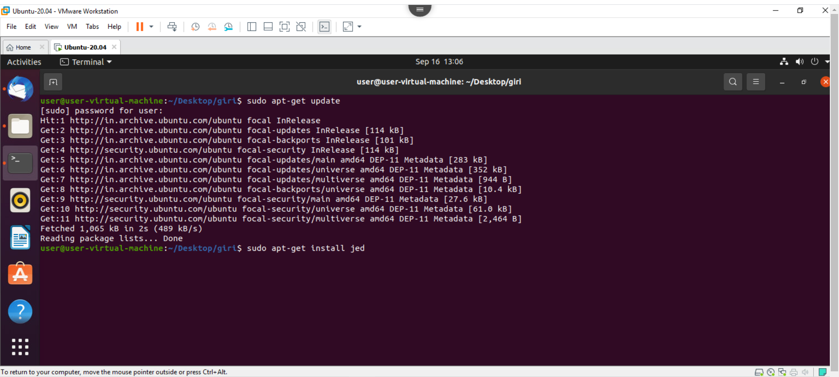

Slide 11
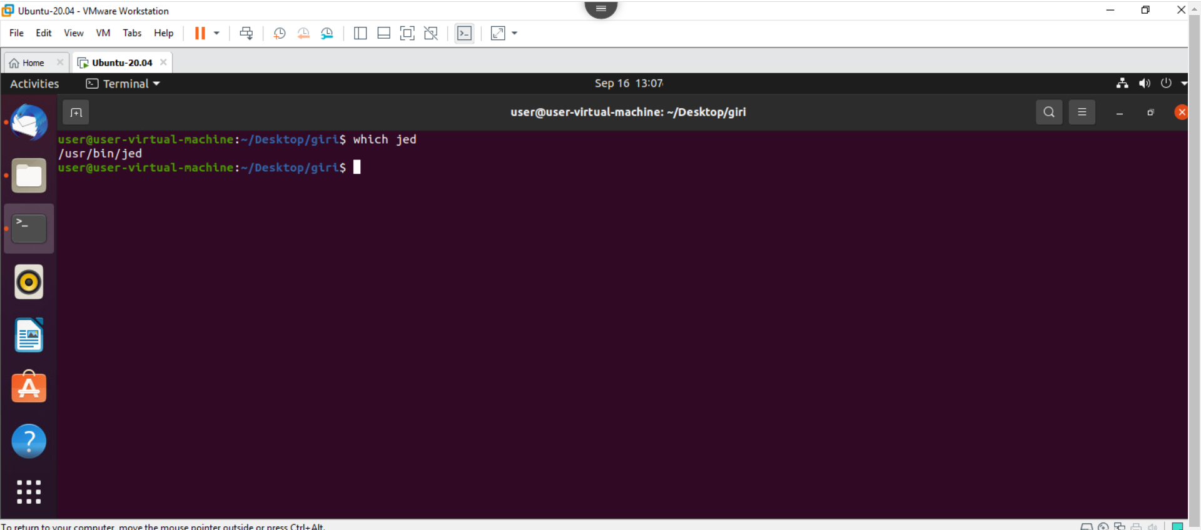

Slide 12
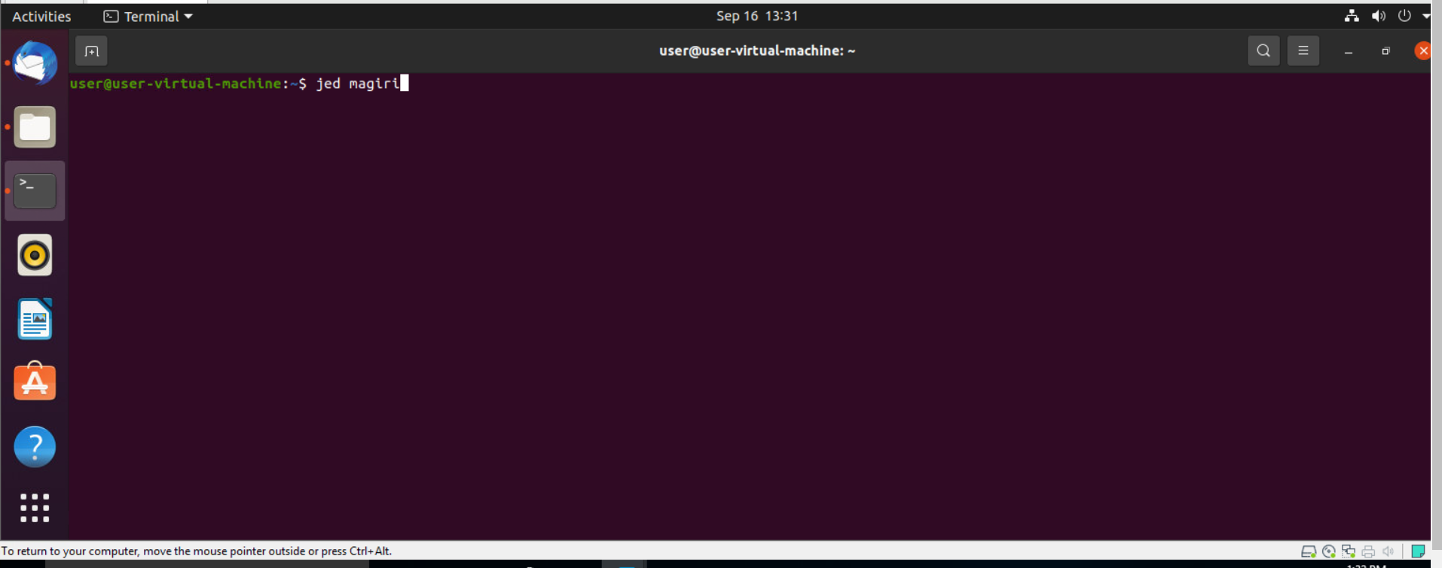

Slide 13
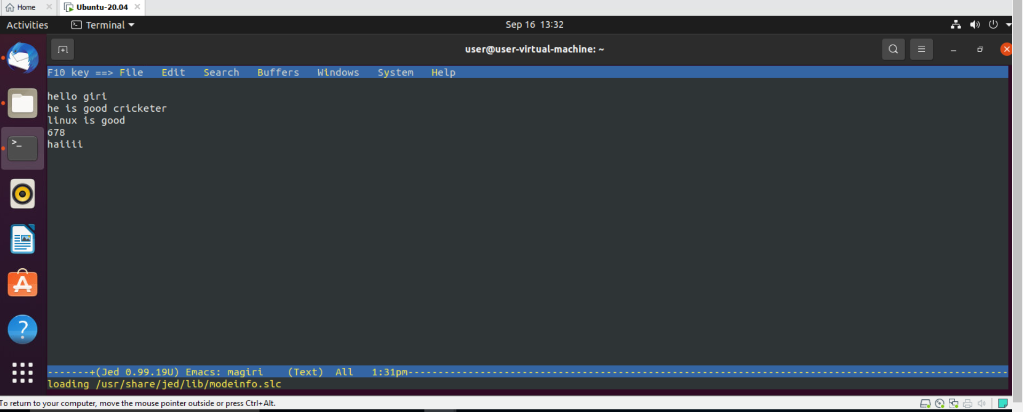

Slide 14
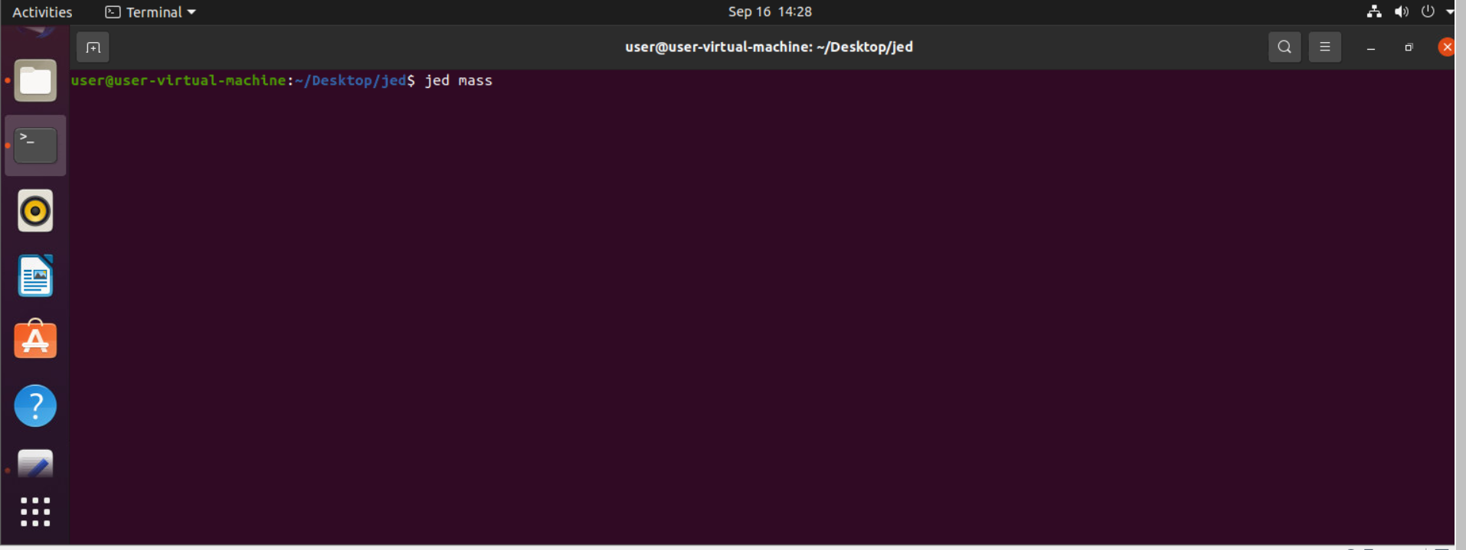

Slide 15
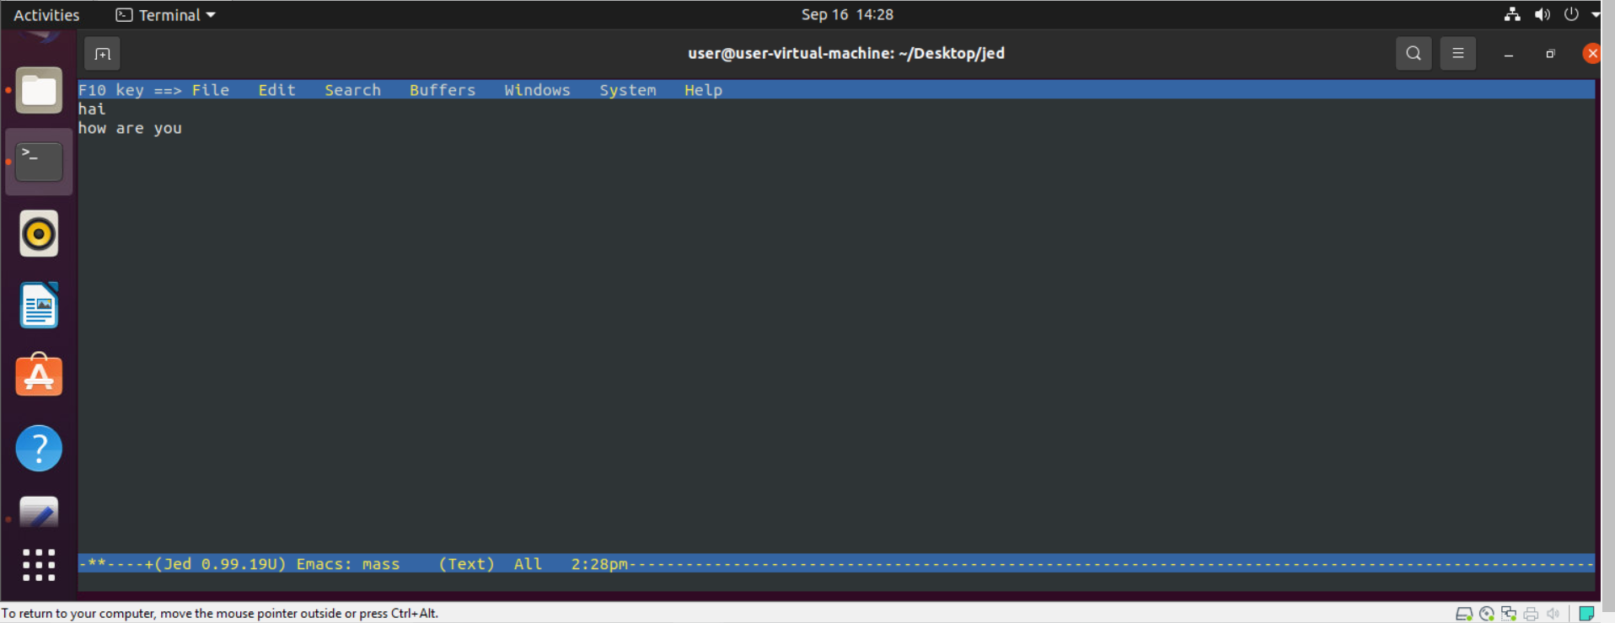

Slide 16
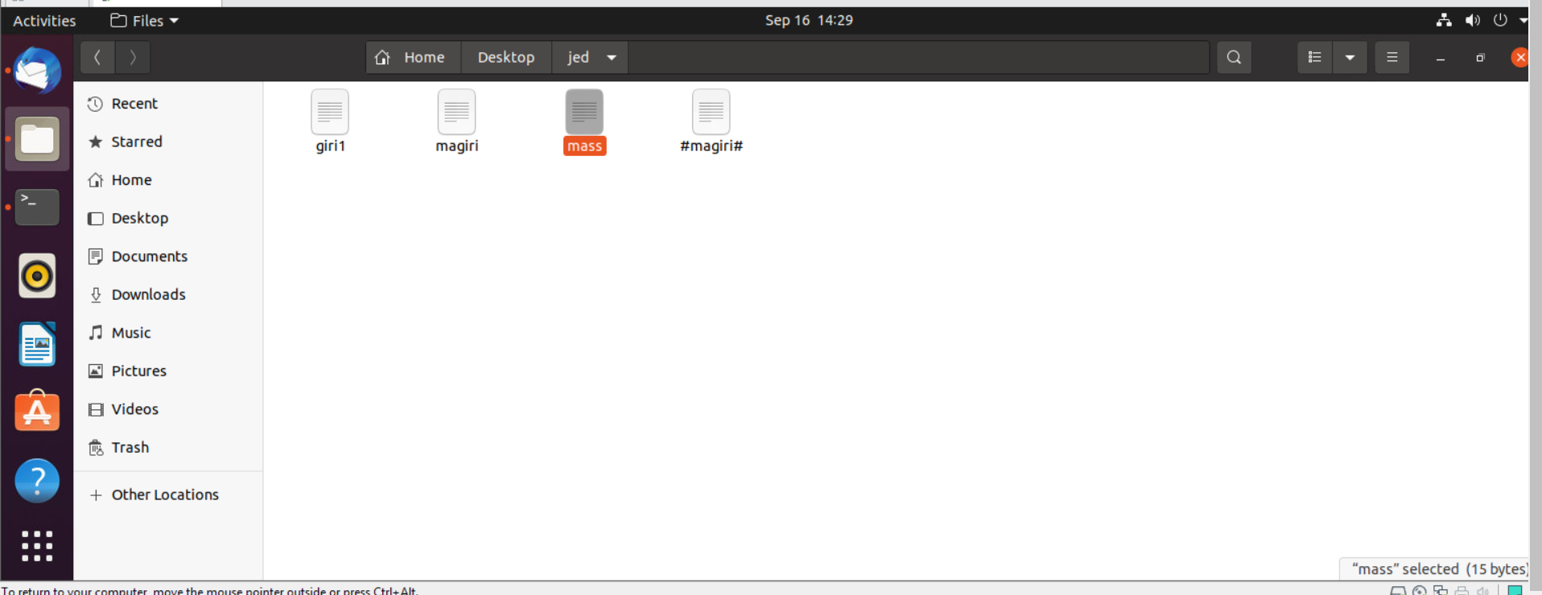

Slide 17
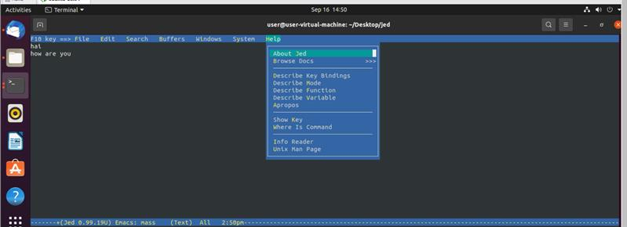

Slide 18
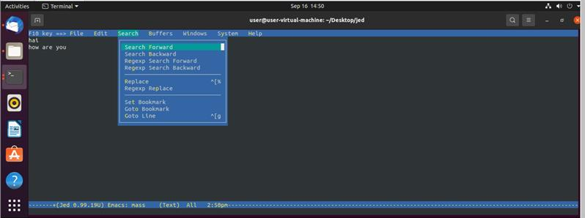

Slide 19
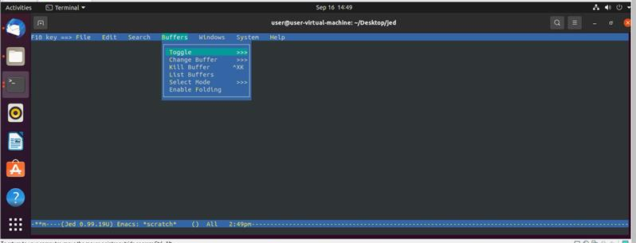

Slide 20
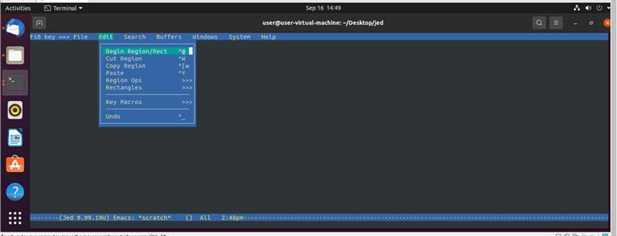

Slide 21
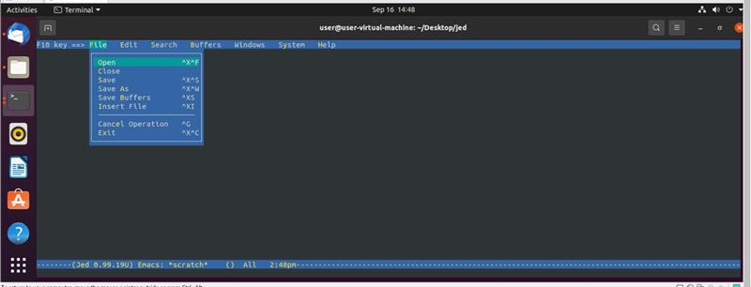

Slide 22
NOTEPAD++
Notepad is used for editing files

Slide 23
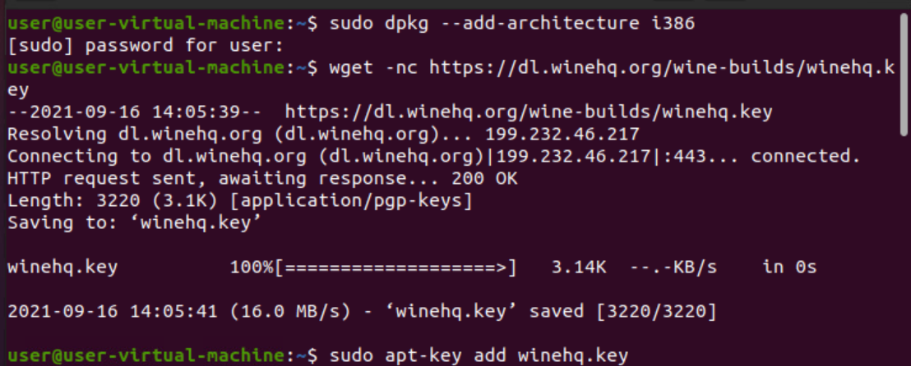

Slide 24
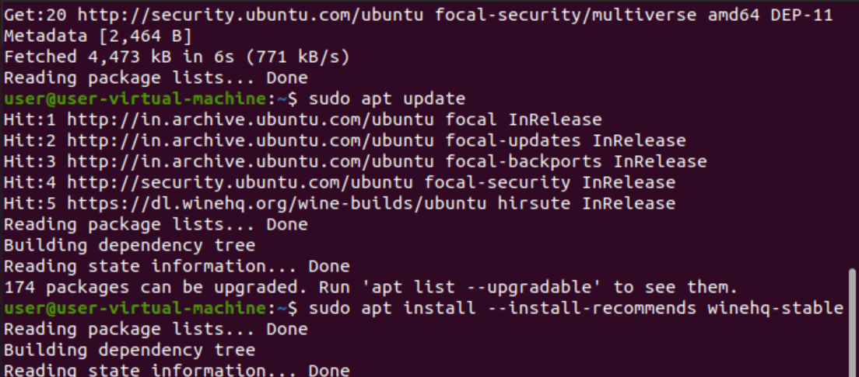

Slide 25
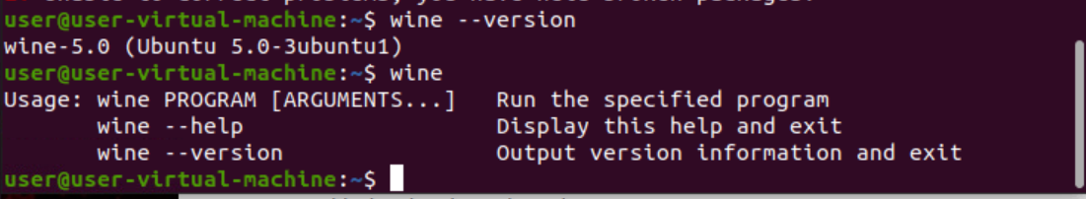

Slide 26
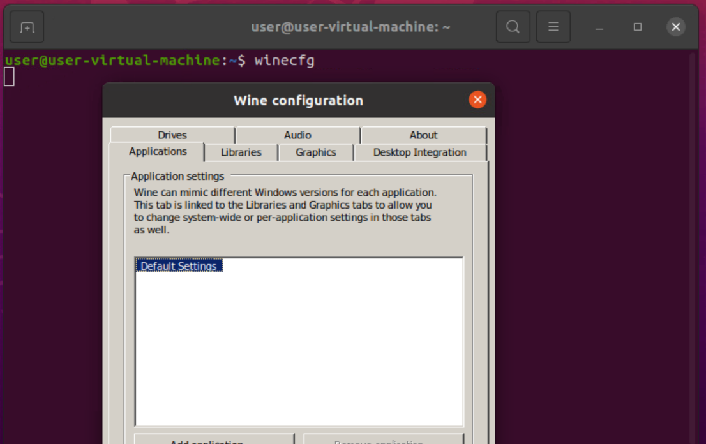
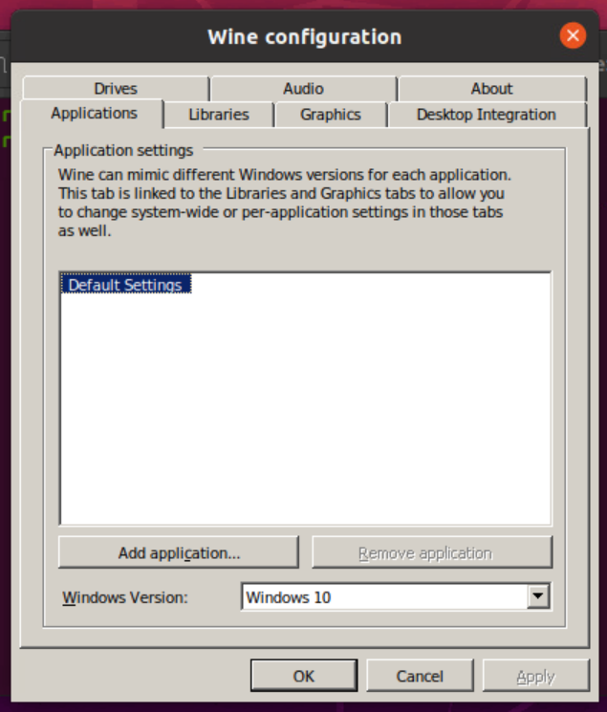

Slide 27
